Slide 1
Discrete Mathematics
(BCSC1010)
Module 1
Pigeonhole Principle

Slide 2
Pigeonhole Principle
If n is a positive integer and n + 1 or more objects (pigeons) are placed into n boxes (pigeonholes) , then there will be at least one box containing two or more of the objects.

Slide 3
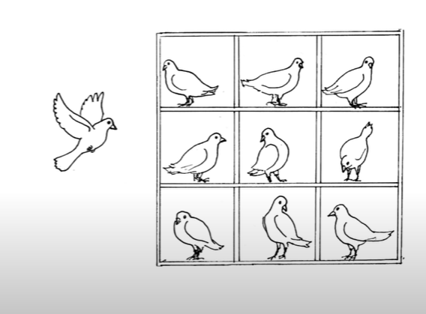
Pigeonhole Principle

Slide 4
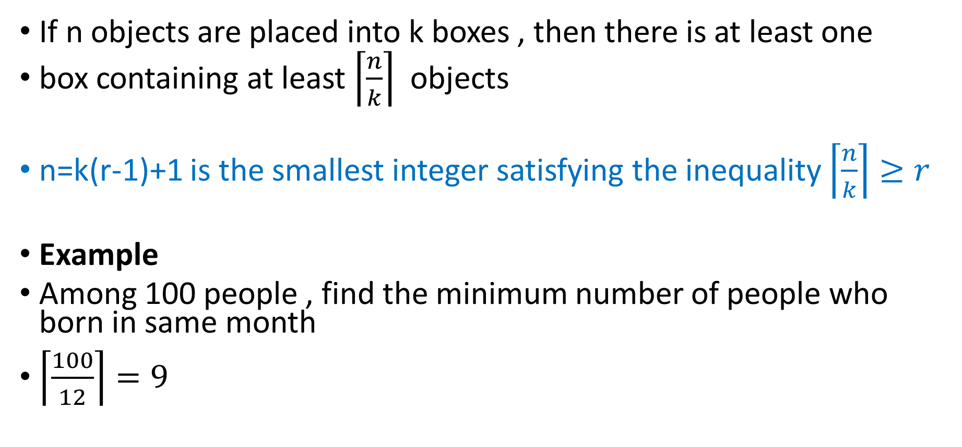
Generalized Pigeon Hole Principle
If n objects are placed into k boxes , then there is at least one
box containing at least $\left\lceil \frac{n}{k}\right\rceil$ objects
n=k(r-1)+1 is the smallest integer satisfying the inequality $\left\lceil \frac{n}{k}\right\rceil ≥r$
Example
Among 100 people , find the minimum number of people who born in same month
$\left\lceil \frac{100}{12}\right\rceil =9$

Slide 5
Example
Suppose a class contains 13 students, then at least two of the students (pigeons) were born in the same month (pigeonholes).
Among 27 English words, at least 2 words begin with same letter

Slide 6
Example
Grade scale 0,……,100 points
How many students must be in a class to guarantee that at least two students receive the same score in the final exam
Total grades: 101 points
Minimum 102 students must be there so that at least two students receive the same score in the final exam

Slide 7
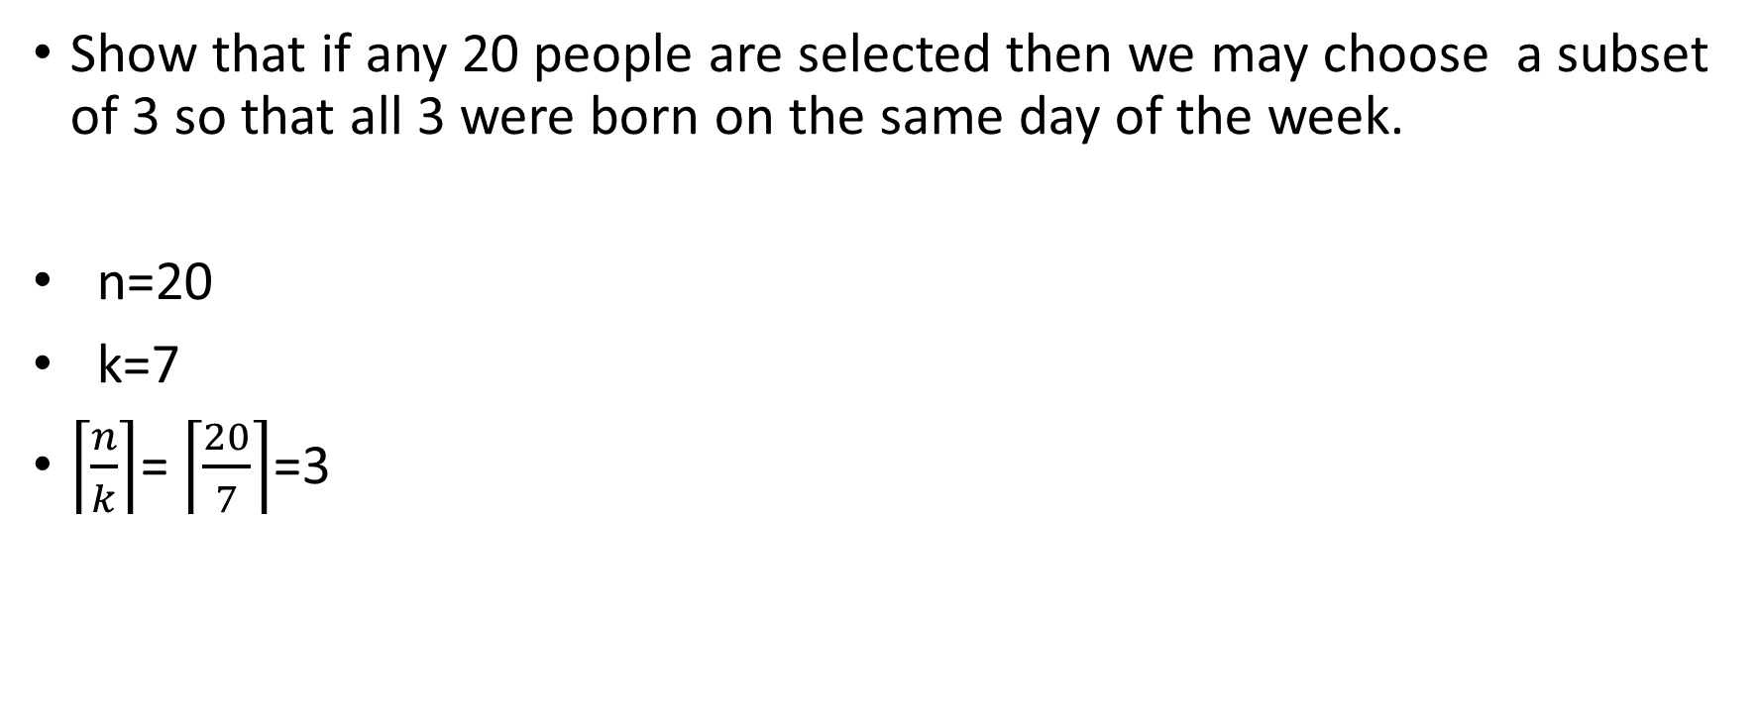
Example
Show that if any 20 people are selected then we may choose a subset of 3 so that all 3 were born on the same day of the week.
n=20
k=7
$\left\lceil \frac{n}{k}\right\rceil$= $\left\lceil \frac{20}{7}\right\rceil$=3

Slide 8
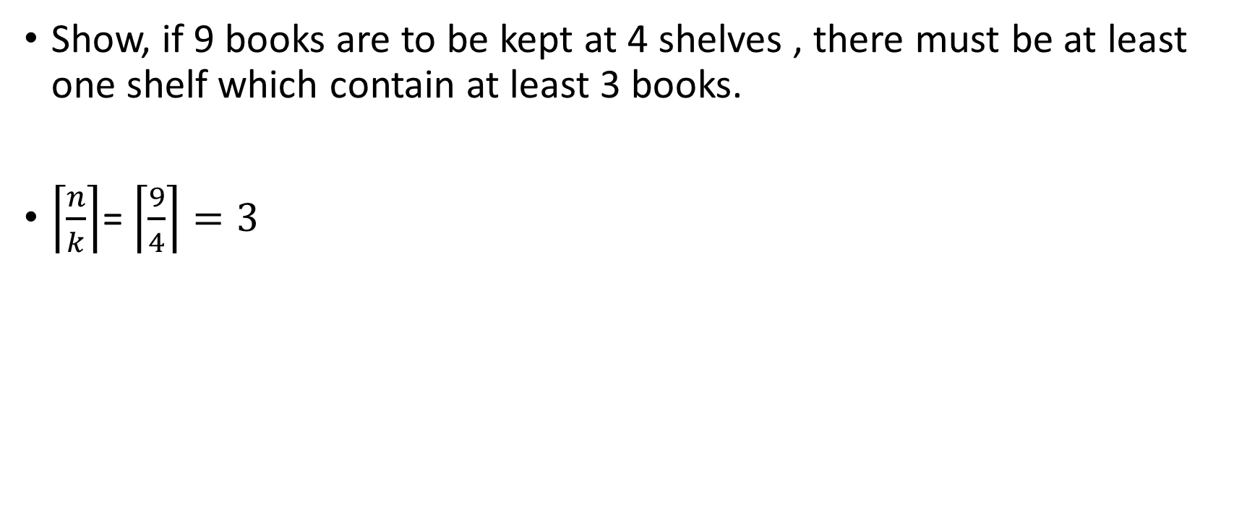
Example
Show, if 9 books are to be kept at 4 shelves , there must be at least one shelf which contain at least 3 books.
$\left\lceil \frac{n}{k}\right\rceil$= $\left\lceil \frac{9}{4}\right\rceil =3$

Slide 9
Extended Pigeonhole Principle
If n pigeonholes are occupied by kn + 1 or more pigeons, where k is a positive integer, then at least one pigeonhole is occupied by k + 1 or more pigeons.

Slide 10
Example
Find the minimum number of students in a class to be sure that 3 of them are born in the same month.
Here the n = 12 months (pigeonholes)
k + 1 = 3 so k = 2
Hence, kn + 1 = 2.12+1
=25 students (pigeons)
Minimum students in class is 25 for three of them born in the same month.

Slide 11
Example
What is the minimum number of students required in a class to be sure that at least 6 of them will receive the same grade , if there are 5 possible grades A,B,C,D and F
n=5 (pigeonholes)
K+1=6 (at least)
=> k=5
Minimum requirement, K.n+1=5.5+1
=26

Slide 12
Example
Find the minimum number of students in a class to be sure that 4 out of them are born in the same month.
n=12 (pigeonholes)
K+1=4
=> k=3
Minimum requirement, K.n+1=3.12+1
=37

Slide 13
Example
Show that if any 20 people are selected then we may choose a subset of 3 so that all 3 were born on the same day of the week.
n=20
k=7
$\left\lceil \frac{n}{k}\right\rceil$= $\left\lceil \frac{20}{7}\right\rceil$=3

Slide 14
Example
Show, if 9 books are to be kept at 4 shelves , there must be at least one shelf which contain at least 3 books.
$\left\lceil \frac{n}{k}\right\rceil$= $\left\lceil \frac{9}{4}\right\rceil =3$
Pigeonhole= 4 shelves
Pigeon= no of books (9)

Slide 15
Example
How many minimum books are to be kept at 4 shelves , there must be at least one shelf which contain at least 3 books.
Pigeonhole= 4 shelves
Pigeon= no of books ?)

Slide 16
Extended Pigeonhole Principle
If n pigeonholes are occupied by kn + 1 or more pigeons, where k is a positive integer, then at least one pigeonhole is occupied by k + 1 or more pigeons.
exp
n=3, k=2, kn+1=7 (pigeons)
Then at least in one pigeonhole k+1=3, pigeon should be there.

Slide 17
Example
Find the minimum number of students in a class to be sure that 3 of them are born in the same month.
Here the n = 12 months (pigeonholes)
k + 1 = 3 so k = 2
Hence, kn + 1 = 2.12+1
=25 students (pigeons)
Minimum students in class is 25 for three of them born in the same month.

Slide 18
Example
What is the minimum number of students required in a class to be sure that at least 6 of them will receive the same grade , if there are 5 possible grades A,B,C,D and F
n=5 (pigeonholes)
K+1=6 (at least)
=> k=5
Minimum requirement, K.n+1=5.5+1
=26

Slide 19
Example
Find the minimum number of students in a class to be sure that 4 out of them are born in the same month.
n=12 (pigeonholes)
K+1=4
=> k=3
Minimum requirement, K.n+1=3.12+1
=37

Slide 20
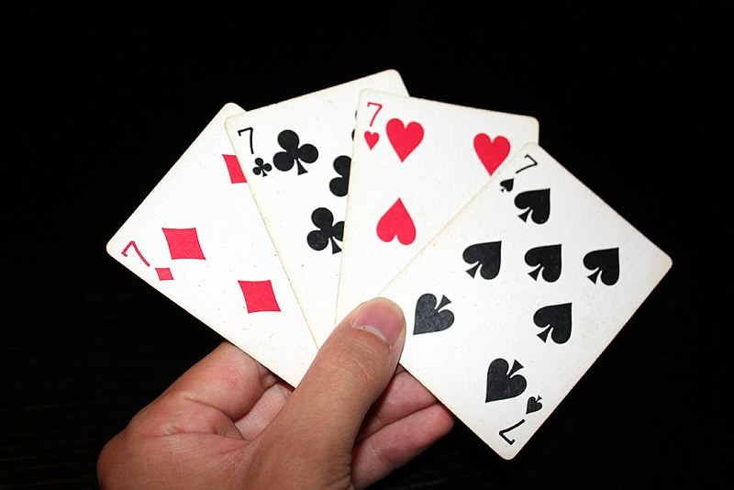
Example
Minimum card must be selected from a standard deck of 52 cards to guarantee that at least three cards of the same suit are chosen?
Club
Diamond
Heart
Spades

Slide 21
Example
n=4 (pigeonholes)
K+1=3
=> k=2
Minimum requirement, K.n+1=2.4+1
=9

Slide 22
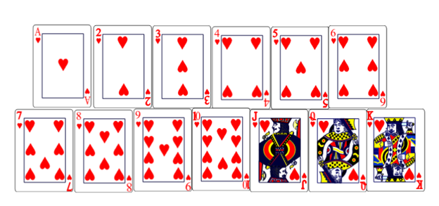
Example
Minimum card must be selected from a standard deck of 52 cards to guarantee that at least three cards of the same kind?
Club
Diamond
Heart
Spades

Slide 23
Example
n=13 (pigeonholes)
K+1=3
=> k=2
Minimum requirement, K.n+1=2.13+1
=27

